Slide 1
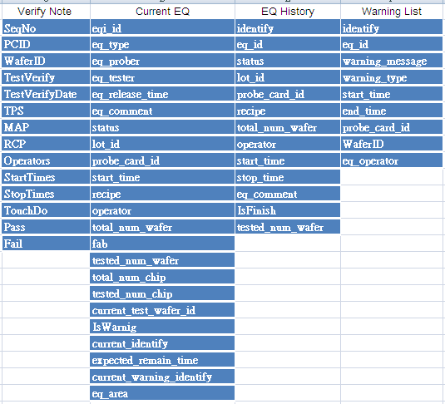
The function block of each DB system

Slide 2
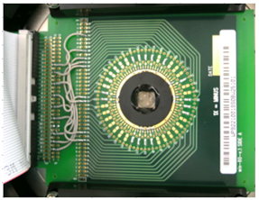

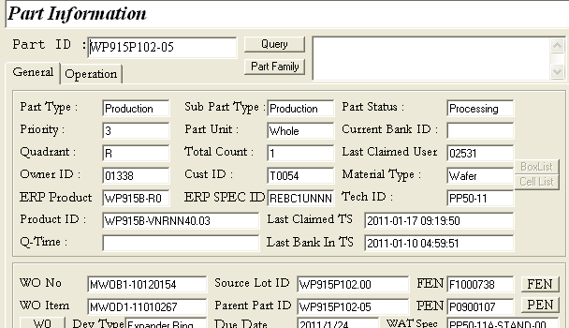
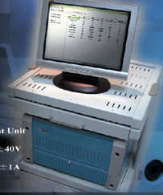
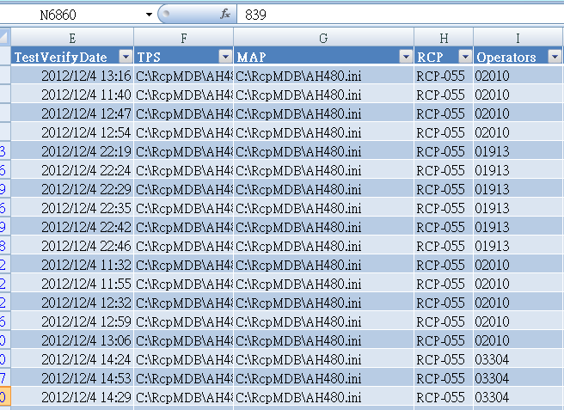
The reporting system (for current DB connection)
1. Probe Card
2. Wafer
3. Yield
4. RCP
5. Raw data output

Slide 3




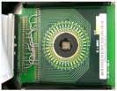


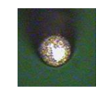
Probe Card
APP: PC touch down
APP: PC VS RCP History
APP: PC Status
APP: PC Order
APP: Needle Status
Current WIP can not support
Handmade module
WIN can build up the module for our propose

Slide 4




Probe Card
APP: PC touch down
Record & Plot
Cancel

Slide 5

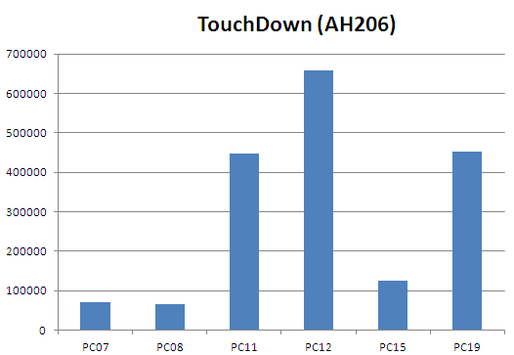

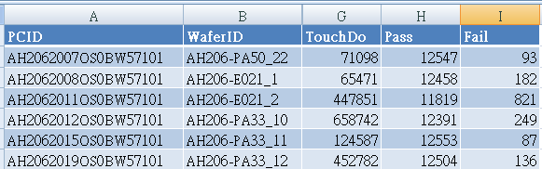
Probe Card
APP: PC touch down
Filter in Mask ID (Verify note)
Filter in site number of Probe card ID (verify note)
Sum the touch down (verify note) by each probe card ID (verify note)
Record & Plot
Cancel

Slide 6
Probe Card
APP: PC VS RCP History
Output excel
Cancel

Slide 7
Probe Card
APP: PC VS RCP History
Output excel
Cancel
Record & Plot
Cancel

Slide 8

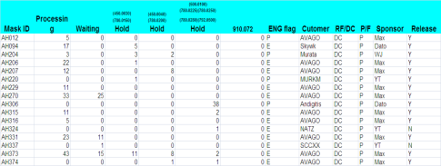
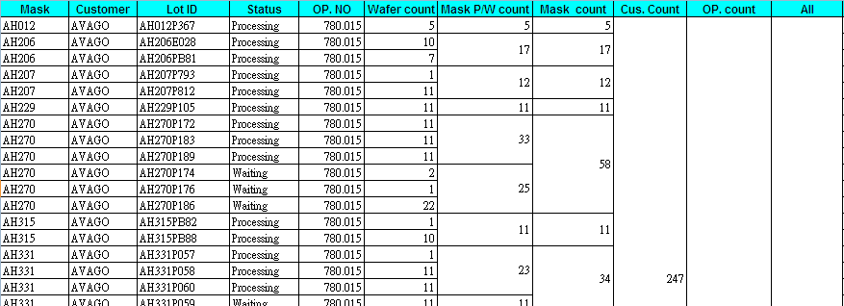
Wafer
APP: Performance index for TE
APP: wafer VS RCP
APP: current WIP
EQ
Data Base
Mutual
Data Base

Slide 9



Wafer
APP: Wafer Quantity
Record & Plot
Cancel

Slide 10
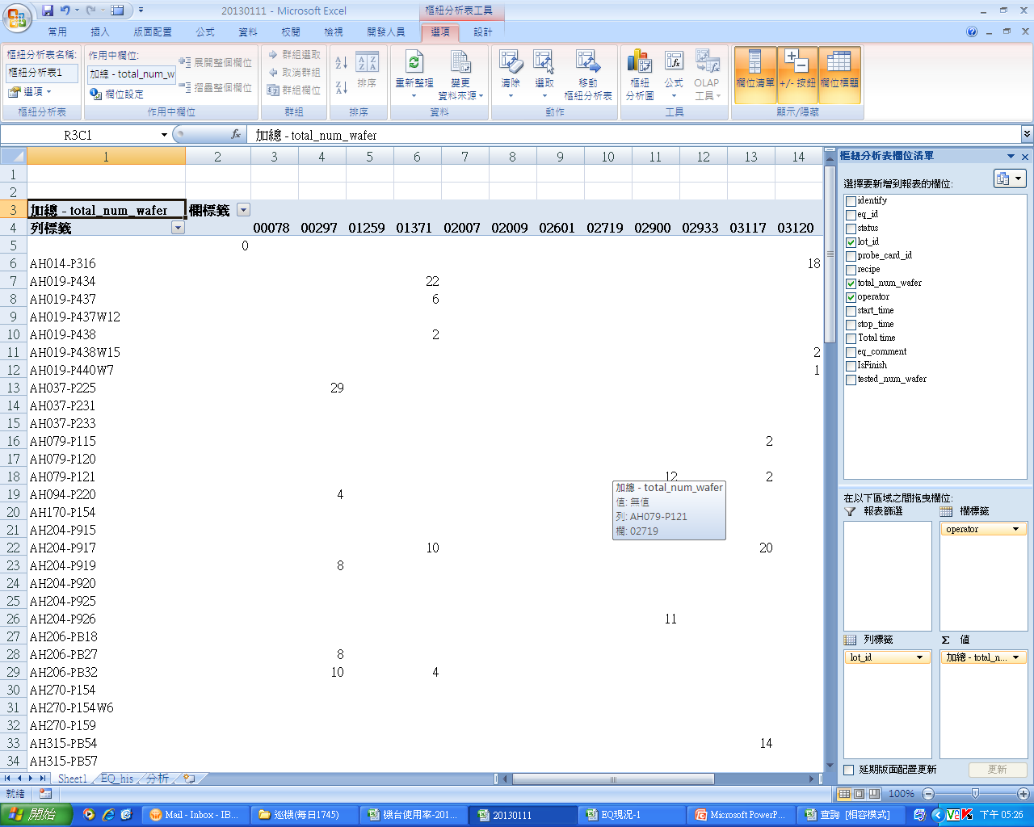
Wafer
APP: Wafer Quantity
Filter by operator, start time (EQ history) and stop time (EQ history)
Calculate the total wafer number information
Record & Plot
Cancel

Slide 11

Wafer
APP: Wafer Quantity
Record & Plot
Cancel

Slide 12
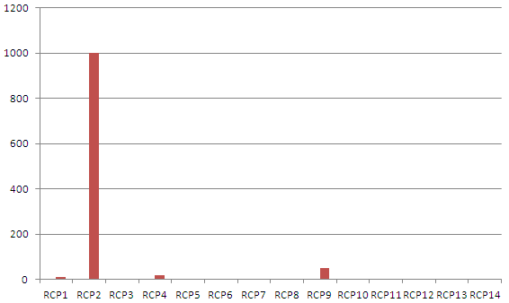
Wafer
APP: Wafer Quantity
Q’ty
Record & Plot
Cancel
Record & Plot
Cancel
RCP

Slide 13
Wafer
APP: Wafer Quantity
Record & Plot
Cancel

Slide 14
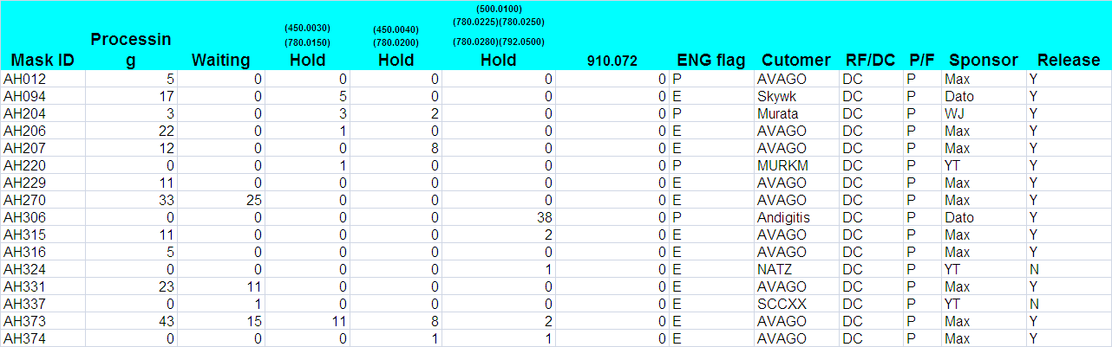
Wafer
APP: Wafer Quantity
Record & Plot
Cancel

Slide 15
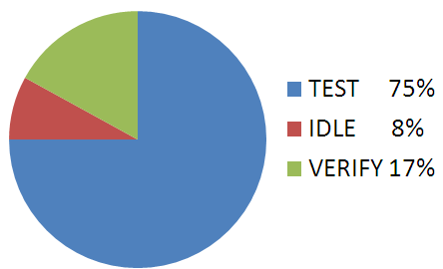
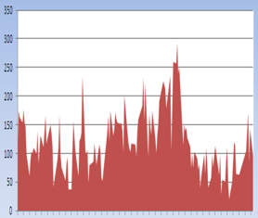
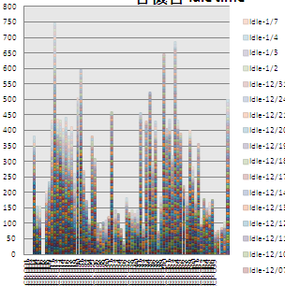
RCP
APP: RCP idle quantity
APP: Total status time
APP: Accumulate RCP idle time
EQ
Data Base
Mutual
Data Base

Slide 16
EQ status
APP: RCP idle quantity
Record & Plot
Cancel

Slide 17


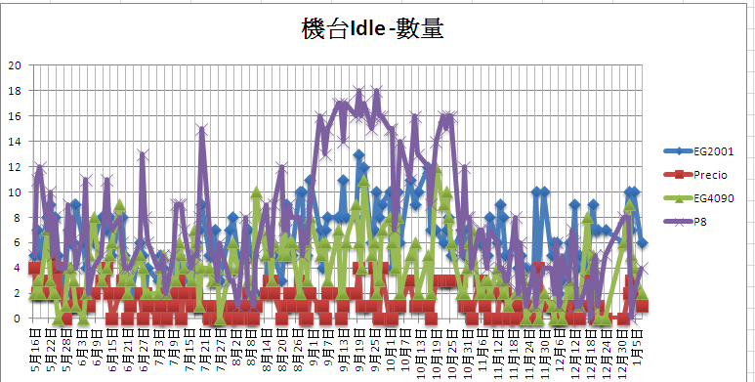
EQ status
APP: RCP idle quantity
Filter by Idle status (Current EQ)
Sorting and plot the EQ_type (Current EQ)
Record & Plot
Record & Plot
Record & Plot

Slide 18


EQ status
APP: Total Idle time
Record & Plot
Cancel

Slide 19


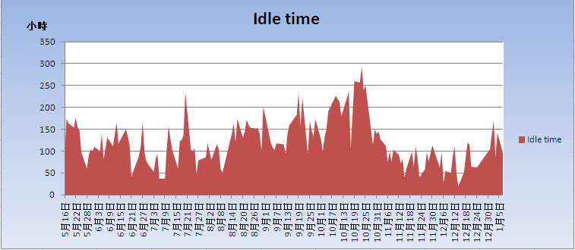

EQ status
APP: Total status time
Filter by Idle status (EQ history), start time (EQ history) and stop time (EQ history)
Plot the total time = stop time – start time
Status
Record & Plot
Record & Plot
Cancel
Cancel
Record & Plot
Cancel

Slide 20
EQ status
APP: Accumulate RCP idle time
Record & Plot
Cancel

Slide 21
EQ status
APP: Accumulate RCP idle time
Filter by status (EQ history), start time (EQ history) and stop time (EQ history)
Plot the total time = stop time – start time
Record & Plot
Record & Plot
Cancel
Cancel
Record & Plot
Cancel

Slide 22

Yield
APP: Different Operator
APP: Different RCP
APP: Different PC
Record & Plot
Cancel

Slide 23
Yield
APP: Operator
Record & Plot
Cancel

Slide 24
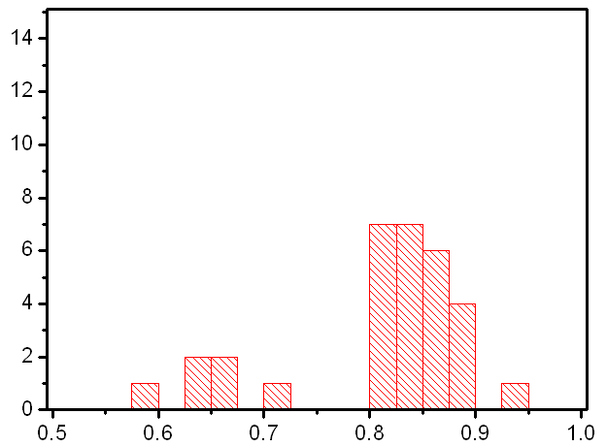
Yield
APP: Operator (1st test)
Filter in Test (verify note)
Filter in Mask (verify note) and Operator
Calculate the Pass die (verify not ) / pass die (PMS)
Q’ty
AS459 @ 01097
Record & Plot
Cancel
Record & Plot
Cancel
Yield

Slide 25
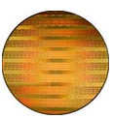

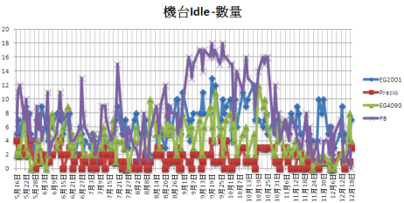

Raw data output
APP: output excel file from DB system
APP: Verify note
APP: Current EQ
APP: EQ History
APP: Alarm
PC
Data Base
Mutual
Data Base

Slide 26



Raw data output
APP: Verify Note
Excel
Cancel

Slide 27
Raw data output
APP: Verify Note
PC
Data Base
Mutual
Data Base

